Slide 1
MAX-CONNECT4 GAME
Under guidance of
Dr. Shivanjali Khare
Assistant Professor,
University Of New Haven.
Submitted by :
Lakshman Kolli,
Vineeth Reddy Naredla

Slide 2
Project Topic
The objective of the project is to built an agent for MaxConnect4 game using minmax, Alpha Beta pruning and depth limited search.
The task is to calculate the streak of 4 and player gets one point for each streak.

Slide 3
Game Description
The game is played on a 6x7 grid, with six rows and seven columns
The game is over when all positions are occupied.
Every complete game consists of 42 moves, and each player makes 21 moves.
The score, at the end of the game is determined as follows: consider each quadruple of four consecutive positions on board, either in the horizontal, vertical, or each of the two diagonal directions (from bottom left to top right and from bottom right to top left).

Slide 4
Modes in the Game:
The game has two modes. They are:
1. Interactive Mode
2. One-move Mode

Slide 5
Interactive Mode
Interactive Mode:
In this mode, one player is computer and another player is human.
Initial move is taken by human or computer based on the parameter passed in the command line argument.
On the move taken by the human, computer takes the counter move.
In this way, each player gets 21 moves.
The final result of this mode gives which player won or loose or tie based on the points achieved and also prints their individual scores.

Slide 6
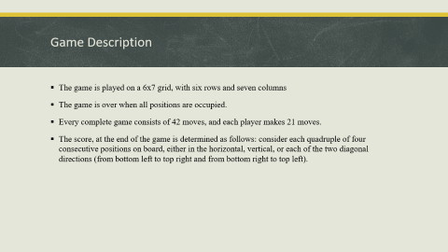
One Move Mode
One-move Mode:
The purpose of the one-move mode is to make it easy for programs to compete against each other, and communicate their moves to each other using text files.
In this mode, depth is given as one of the parameters. Depth indicates the state of the current board at the given depth.
Based on the current mode taken from the depth, the computer will predict the next best possible move.
Based on the depth given, the time taken to execute the code also varies.
As the depth increases, the time taken to execute also increases.

Slide 7
Approach
Tools used :
  Python Shell
Techniques used :
  minmax, Alpha Beta pruning and depth limited search
evaluation function is used to find the next possible move.
To get the next best possible move, we implemented an utility function to calculate the utility value.
Below is the Utility formulation:
selfScore = self_fours * 4 + self_threes * 3 + self_twos * 2
opponentScore = opponent_fours* 4 + opponent_threes *+ opponent_twos * 2
utilityValue = selfScore - opponentScore

Slide 8
Deliverables
The game has two python files.
  Maxconnect4.py - It contains oneMoveMode and Interactive mode functions.
  MaxConnect4Game.py - It contains minimax function, aiPlay function and evaluation_function.
User documentation manual as .MD file.
Project proposal ppt.

Slide 9
Evaluation Methodology
Algorithms used are minmax(Alpha Beta pruning and depth limited search).
Minmax algorithm is used in decision-making as it provides optimal moves for player assuming opponent playing optimally.
Alpha-Beta, depth limited search used for faster searching and even go deeper levels in game tree.
We use 7*6 grid, so there will be 42 moves and each player(player1, player2) makes 21 moves.
The game is over when all positions are occupied and winner will be declared based on points earned.
Each quadruple of four consecutive positions on board, either in horizontal, vertical, or each of two diagonal directions gives a player a point.
At end of the game, whoever player has the highest number of points wins the game and will be declared as winner.

Slide 10
One Move Mode - Procedure
Read the input file and initialize the board state and current score, as in interactive mode.
Print the current board state and score. If the board is full, exit.
Choose and make the next move.
Print the current board state and score.
Save the current board state to the output file IN EXACTLY THE SAME FORMAT THAT IS USED FOR INPUT FILES.
Exit

Slide 11
One Move Mode - Execution Command
One-move Mode:
$ python maxconnect4.py one-move [input_file] [output_file] [depth]

Slide 12
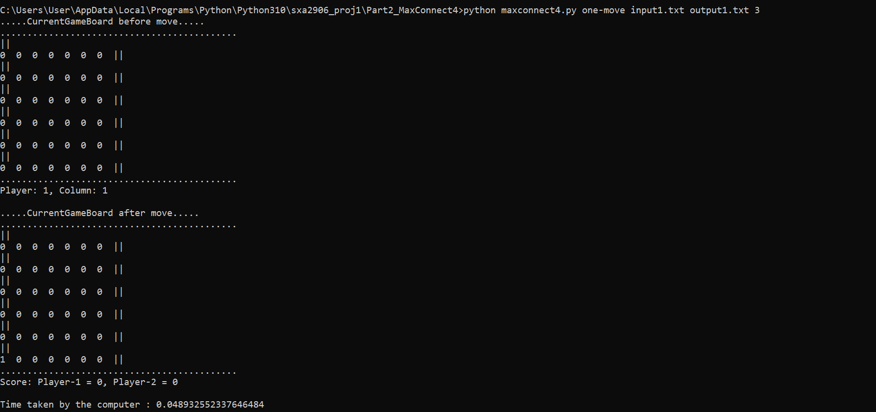
One Move Mode - Sample Execution

Slide 13
One Move Mode - Time Complexity Analysis
Depth | Time (in seconds)
1 | 0.01587
2 | 0. 01606
3 | 0.05740
4 | 0.22850
5 | 1.03433
6 | 3.41592
7 | 22.7656
8 | 59.6229
9 | 496.521

Slide 14
Interactive Mode - Procedure
If computer-next, goto 2, else goto 5.
Print the current board state and score. If the board is full, exit.
Choose and make the next move.
Save the current board state in a file called computer.txt (in same format as input file).
Print the current board state and score. If the board is full, exit.
Ask the human user to make a move (make sure that the move is valid, otherwise repeat request to the user).
Save the current board state in a file called human.txt (in same format as input file).
Goto 2.

Slide 15
Interactive Mode - Execution Command
Interactive Mode:
$ python maxconnect4.py interactive [input_file] [computer-next/human-next] [depth]

Slide 16
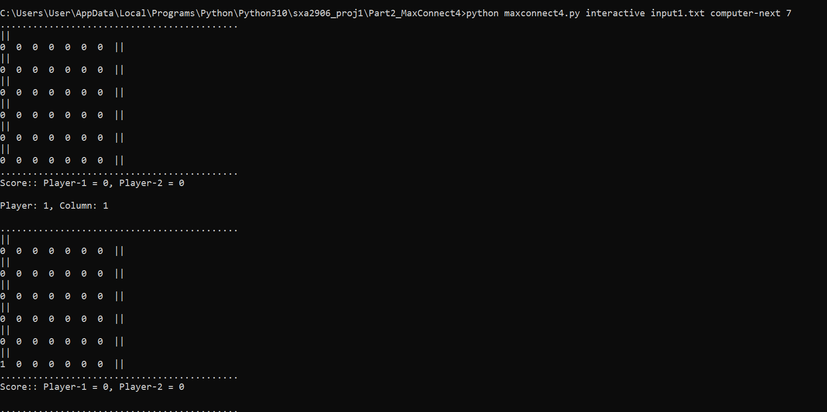
Sample Execution – Interactive Mode

Slide 17
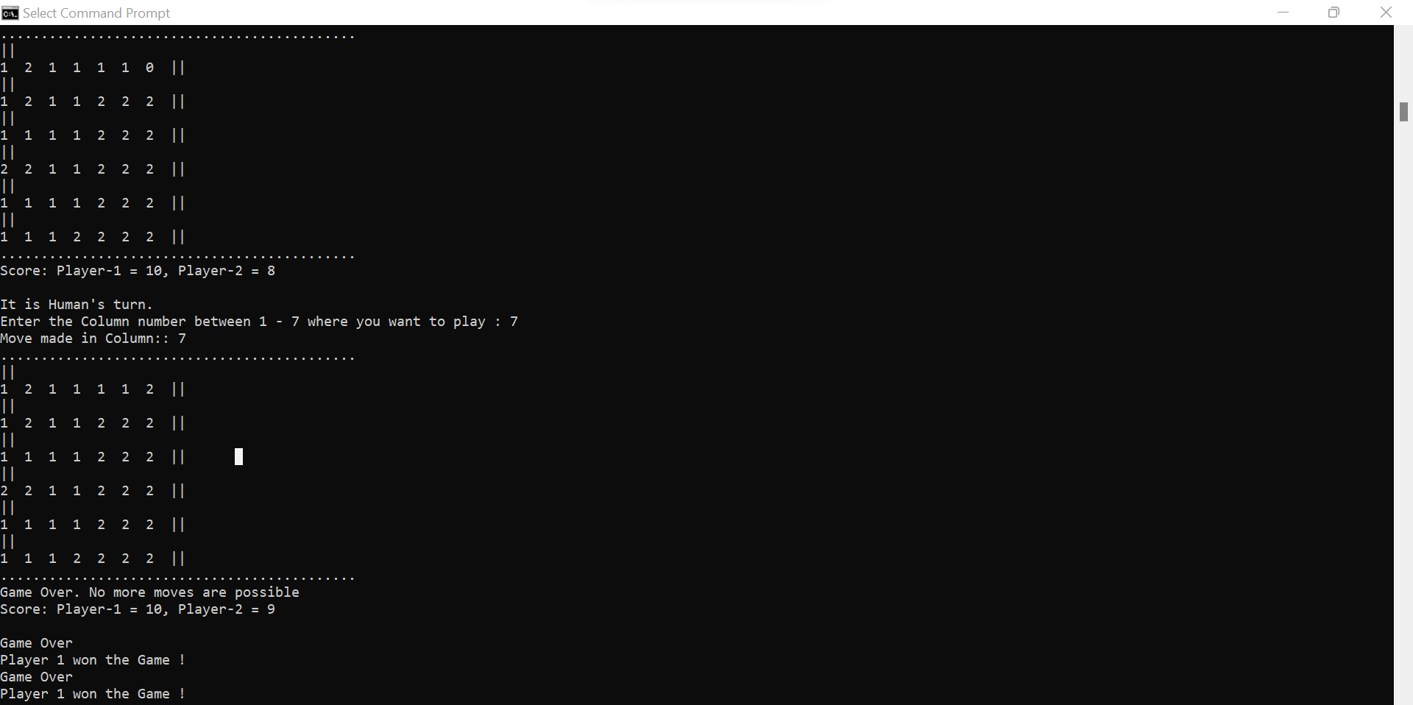
Continue…

